Slide 1


Together, we are working toward a healthier community.

Slide 2

Agenda:
Open Enrollment
Benefit Highlights
Wellness
SPS Benefit System
Contractual Employees
Domestic Partner Eligibility
EBD Reminders
Questions and Answers

Slide 3

Open Enrollment

Slide 4

Open Enrollment
October 16 - November 9, 2023
Important Dates:
October 16: Open Enrollment begins
November 9: Open Enrollment closes at 5 pm
More than 4,000 employees have qualified under the ACA measurement period
Dependent Verification Review (DVR) …ongoing
All materials available online as of October 12th
Printed materials mailed only to Retirees and COBRA participants
Hybrid Campaign
~ Virtual
On-Demand Open Enrollment Materials & Videos at mymdbenefits.com
Virtual meetings offered by all carriers between October 16th and November 6th
Home Page.
~ In-person
10 locations throughout the State
All carrier partners will be available with materials. Schedule to follow.

Slide 5

Dependent Verification Review (DVR)
When adding a new dependent during Open Enrollment, required supporting documentation must be attached to the Open Enrollment Event in SPS.
Required dependent(s) documentation must be uploaded by 11/9/2023 at 5:00pm OR the newly added dependent(s) will be removed from Open Enrollment coverage
New Dependent(s) will not have coverage effective January 1, 2024
Employees can take pictures of the required documentation and upload legible screenshots to the Open Enrollment event OR
Upload documents to: Maintain Worker Documents, the upload category should be Benefits or Benefits Correspondence.
Please reference the updated Dependent Documentation Requirements emailed to you on August 31, 2023.
Upload Today

Slide 6
Benefit Highlights

Slide 7
Highlights 2024
Domestic Partner Eligibility: effective January 1, 2024
Wellness Program participants: Obtain a routine eye exam for an additional $5 reduction on your specialist copay.
Flu shots are available at your local retail pharmacy using your CVS Rx card- $0 Copay
Benefits plans are unchanged
Increase in premiums
FSA Maximum Deferral is $3,050
View our website or mymdbenefits.com for details
2024 Rx Formulary updates (updates to follow)
Member notification
Physician notification
No changes to the Retiree EGWP Program

Slide 8
Reminder 2024:
Birth Events: Dependent Documentation Requirement
An official birth certificate must be submitted with the birth event in order to add a newborn.
Members continue to have 60 days to initiate and finalize birth events when enrolling their newborn.
Remember: temporary documents such as crib cards, hospital verifications of birth are not acceptable documents

Slide 9
Wellness

Slide 10

Wellness 2024
2023 Participants-no 2024 Activity reset!
However, new participants can complete the activities in 2024 and enjoy the rewards through 12/31/2024
Wellness program managed by your medical carrier
Activities for $0 PCP Copay
Select or Confirm PCP
Complete HRA (Health Risk Assessment)
Kaiser members: Sign online HIPAA release
Activities for $5 discount on Specialist Copay (total $10)
Obtain an annual routine eye exam
Complete any age/gender preventive screenings

Slide 11
Wellness 2024
Wellness program managed by your medical carrier and includes motivating digital resources you can access anytime anywhere! Examples include:
Health Surveys (annual and on demand) and Personalized Health timelines to include recommendations, content and services available to you
Health Profile for maintaining all your health data in one place
Trackers: Connect your wearable devices or enter your own data to monitor sleep, steps, nutrition and more
Wellness Coaching at no cost – 1:1, available via telephone or online
No cost Weight Management and Diabetes Prevention Programs
No cost mental/emotional health resources (excludes treatment)
Fitness Membership Discounts

Slide 12











More Wellness 2024… Free Resources for Everyone!
Weekly Wellness Webinars
4-5 Wellness Challenges Each Year
Wellness Webinar Library
Found on the Wellness Website!

Slide 13

844-405-8200
portal.bhsonline.com
(Org ID: MYMDCARES)
No-cost, confidential program. No benefit elections necessary.
Provides 24/7 services and resources to active employees and dependents* of State Personnel Management System, Maryland Department of Transportation, Judiciary and Legislature, including all full and part-time employees and contractual employees
*Interns, Contingent and Temporary employees are not eligible. Not available to NonSPMS agencies, including, the University System, Register of Wills for all Counties, Maryland Stadium Authority, etc.
Services include:
Master's level clinician "care coordinators“
Short-term counseling- Up to 5 sessions per issue per year
(no limit on the number of issues)
Referrals to long-term providers, community resources or other programs
Free unlimited telephonic financial consultations
Free 30-minute telephonic or in-office legal consultations
Dedicated MyMDCARES web portal with locator services, on-demand training, articles, additional resources, easy access

Slide 14


Financial Wellness: Upwise
Upwise from MetLife is a no-cost confidential financial wellness app available to all State of Maryland Employees
Participation does not depend on benefit eligibility and no election is required for participation
Based on behavioral science, designed to help build financial progress through good money habits
Download the app: App Store or Google Play
Notes:
Upwise offers 3 categories of challenges: Do it for me, do it with me, and teach me. Do it for me: Upwise takes actions on your behalf, like canceling a subscription or negotiating the cost. Do it with me: Upwise suggest actions you can take toward a financial goal. Teach me: Upwise provides financial education and tips to practice what is learned. This approach creates a personal experience that helps develop good money habits. And the more the app is used, the more tailored the recommendations and actions become. Upwise will celebrate small wins with you, which increases financial confidence and optimism about what can be accomplished financially.

Slide 15
SPS Benefit System

Slide 16
Open Enrollment
The SPS Benefits System User Interface features “tiles” for quick reference.
The screen allows the employee/retiree to view all current elections at a glance and then decide which, if any, they want to change.
Dependents already in the system are clearly visible; this will help reduce duplicate dependents.
The Quick Reference Guide is posted to the SPS Benefits Help Center website OR
On the member’s SPS Benefits System home page
The Open Enrollment Event is accessible on the SPS Home Page/ Announcements Section from 10/16/23-11/9/23 at 5 pm.

Slide 17
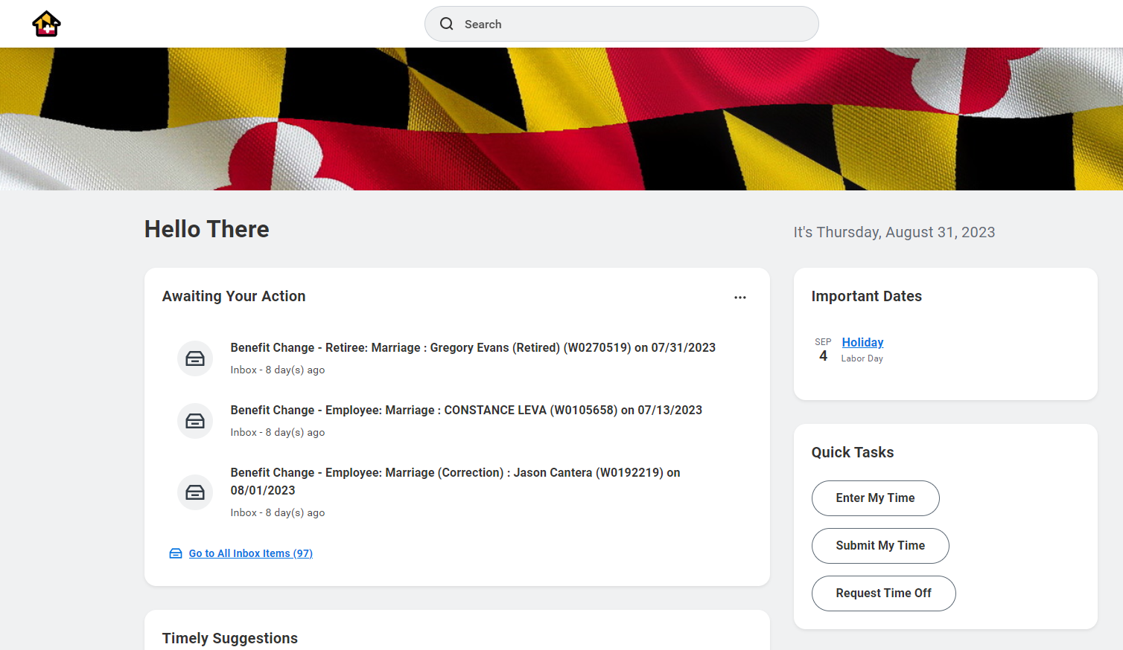
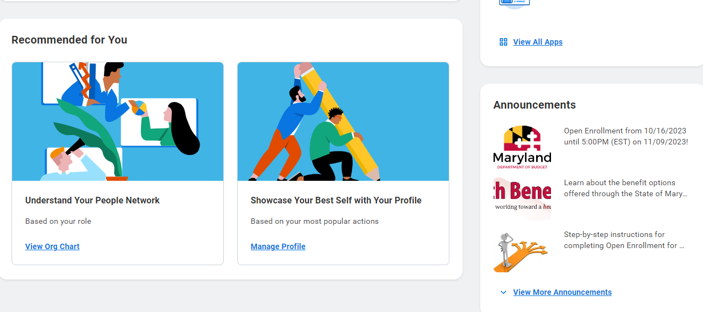
SPS Homepage/Announcements

Slide 18
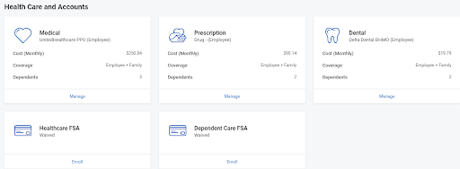
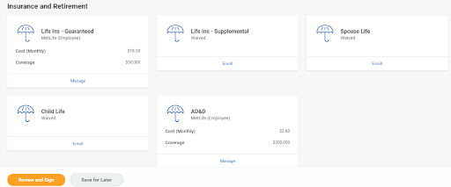
Open Enrollment User-Interface
Employees/Retirees will select either MANAGE or ENROLL to:
View more details
Add/Remove Dependents
Change Plans
Change Coverage Amount
After completing elections, select REVIEW AND SIGN to attach new dependent documentation and submit elections
Notes:
This is a sample Picture Right with Caption slide ideal for including a picture with a brief descriptive statement.
To Replace the Picture on this Sample Slide (this applies to all slides in this template that contain replaceable pictures)
Click the icon inside the shape to open the Insert Picture dialog box. Navigate to the location where the picture is stored, select desired picture and click on the Insert button to fit the image proportionally within the shape.
Note: Do not right-click the image to change the picture inside the picture placeholder. This will change the frame size of the picture placeholder. Instead, follow the steps outlined above.
Tip: use the Crop tool to reposition a picture within a placeholder. From the Picture Tools Format tab on the ribbon, click the Crop button. Click and drag the picture within the placeholder to reposition. To scale the picture within the placeholder (while Crop is active), grab a round corner handle and drag to resize. Hold Shift key to constrain picture aspect ratio when resizing.

Slide 19
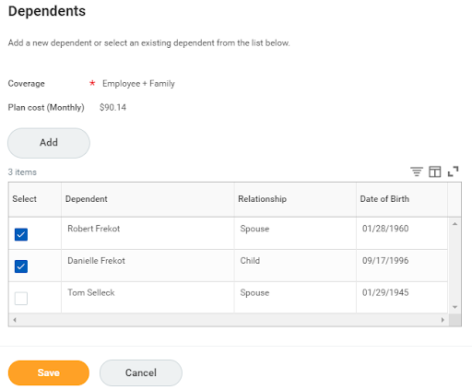
Open Enrollment User-Interface
Add new dependents
Add or Remove listed/eligible dependent(s) from coverage
Notes:
This is a sample Picture Right with Caption slide ideal for including a picture with a brief descriptive statement.
To Replace the Picture on this Sample Slide (this applies to all slides in this template that contain replaceable pictures)
Click the icon inside the shape to open the Insert Picture dialog box. Navigate to the location where the picture is stored, select desired picture and click on the Insert button to fit the image proportionally within the shape.
Note: Do not right-click the image to change the picture inside the picture placeholder. This will change the frame size of the picture placeholder. Instead, follow the steps outlined above.
Tip: use the Crop tool to reposition a picture within a placeholder. From the Picture Tools Format tab on the ribbon, click the Crop button. Click and drag the picture within the placeholder to reposition. To scale the picture within the placeholder (while Crop is active), grab a round corner handle and drag to resize. Hold Shift key to constrain picture aspect ratio when resizing.

Slide 20

Agency Readiness Checklist
Assure all employees know how to log into SPS Benefits using OneLogin
https://stateofmaryland.onelogin.com/
Website URL, W#, Quick Reference Guide
Verify all employees have an email address in order to receive EBD OE notifications
Current Work and/or Personal
Have a communication plan for employees with no email and/or internet access
Be sure employees know they will have to upload the appropriate documentation for newly enrolled dependents AT THE TIME OF ENROLLMENT
Review: SPS Benefit Expiring Contract Report NOW!
Contact employees and/or departments to get contract updates before September 28th Shell Record file.

Slide 21

Agency Readiness Checklist Continued….
ABC’s must run their agency’s SPS Benefit Open Election Events – Employees report prior to the start of Open Enrollment
The report will list all employees with an open New Hire, Job Change or Life Event; these events will cause the employee’s Open Enrollment event to go “On Hold”
The Open Enrollment event will remain “On Hold” until these earlier events are completed/submitted/approved
Employees will not be able to access the “On Hold” Open Enrollment events
Follow up frequently- Running your agencies SPS Benefits Open Election Events
EXAMPLE: An employee initiates a Birth/Adoption event prior to 10/10/2023 and the event is still “open”; the Open Enrollment event will be “On Hold” until the Birth/Adoption event is completed
Done!

Slide 22
Open Enrollment Events-Special Notes
The SPS Open Enrollment will default to the current employee/retiree elections
and dependents except for FSA elections.
Open Enrollment allows employees/retirees to change plans, add/delete eligible dependents and/or waive coverage
FSA elections are a mandatory re-enrollment (no rollover)
FSA Healthcare maximum is now $3,050
Life Events between the 1st day of Open Enrollment and 1/1/2024, will re-open the Open Enrollment events after the employee completes Life Event election
The employee needs to review, complete and submit the re-opened Open Enrollment event to ensure they have the elections they desire for 2024.
ABC’s - Monitor these events to ensure employees are completing the process by continually running the SPS Benefit Open Enrollment Events Report.
Use the 1. SPS Benefits Open Election Events-Employees and 2. SPS Benefit Open Enrollment Events-Employees reports to monitor your employees.
No Correction period, no exceptions-no crying!
No paper enrollment forms will be accepted by EBD

Slide 23
Contractuals

Slide 24

Contractual Employee Contracts
Contractual employees must have an OPEN CONTRACT with an end date of 1/2/2024 or later in order to receive their Open Enrollment Event on 10/16/2023 .
SO ABC’s
Run the SPS Benefit Expiring Contract Report to identify Active Contractual employees with an expiration date prior to 1/2/2024 who may be impacted.
Run Report Today

Slide 25
Contractual Employee Contracts continued..
Contracts that start on January 1, 2024 and are for 90 days or less will not meet the eligibility rules for an Open Enrollment event, so please make sure Contract Start Dates and Contract End Dates are accurate for the type and length of employment
The only exception are employees identified as ACA Eligible for 2024 in the Measurement Period Reporting. These employees need an Active contract on January 1, 2024 and it can be less than 90 days in duration
Benefits Only Agencies should send the January 1, 2024 contracts in the Delta File no later than September 28, 2023, to ensure timely processing into SPS without errors
SPMS and CPBI Agencies should make sure any contracts expiring prior to January 1, 2024, are updated by October 10, 2023

Slide 26
Open Enrollment Event Process Contractuals
 | EMPLOYEE STATUS | OE EVENT PROCESS
Open Enrollment Event Process | 2023 ACA Flag + 1/1/24 Contract Contract in Workday by 10/10/23 | Employee Receive SPS OE Event on 10/16
 | No 2023 ACA Flag + 1/1/24 Contract Contract in Workday by 10/10/23 | Employee Receive SPS OE Event on 10/16
 | 1/1/24 Contract Contract entered in Workday after 10/11/23 and on or before 11/9/23 | Employee will receive a manually generated OE Event Employee will have until 5pm on 11/9 to Complete Online Enrollment
 | 1/1/24 Contract Contract entered in Workday on or after 11/9/23 and on or before 12/31/23 | Employee will receive a manually generated OE Event Employee will have 14 Calendar Days to Complete the Online Enrollment
 | 1/1/24 Contract Contract entered in Workday on or after 1/1/24 | Employee will receive a manually generated OE Event Employee will have 14 Calendar Days to Complete the Online Enrollment

Slide 27
Open Enrollment Event Process Retirees
 | EMPLOYEE/RETIREE STATUS | OE EVENT PROCESS
Open Enrollment Event Process | Current Retiree in Workday With a Retiree Benefit Group | Retiree receive an SPS OE Event on 10/11
 | Current Employee Retiring on 1/1/24 | Employee Will Receive SPS OE Event on 10/16 New Retiree Must Submit Paper Retiree Enrollment Form to EBD for Processing The Elections Submitted on the Paper Enrollment Form Will Supersede Anything Elected in the Employee SPS OE Event
 | Deferred Retiree for 1/1/24 | Retiree Must Submit Paper Retiree Enrollment Form to EBD for Processing

Slide 28
Sending a 2024 Contract in a Delta File
THIS INFORMATION APPLIES TO BENEFITS ONLY AGENCIES
Benefits Only Agencies can send contract extensions or renewals PRIOR to the Contract End Date of the existing contract
For full details visit https//dbm.Maryland.gov/sps/Pages/BenefitsShell.aspx
Your IT team can follow the instructions under the “All questions and responses”
“Shell Record Communication”-Posted 31518
Use the examples as general guidelines only
Action Code = 03
Effective Date = 09/05/2023
Contract Data Change Flag = 1
Original Contract Number = 2024 Contract
Contract Start Date = 07/01/20
Contract End Date = 06/30/24
Action Code = 03
Effective Date = 09/05/2023
Contract Data Change Flag = 1
New Contract Number = 2024 Contract
Contract Start Date = 01/01/24
Contract End Date = 06/30/24
Contract Extension Example
- extending the Contract End Date for an existing contract
Contract Renewal Example
- issuing a new Contract Number for an existing active employee
Notes:
This is a sample Two Pictures with Captions slide ideal for including two pictures with brief descriptive statements.
To Replace the Pictures on this Sample Slide (this applies to all slides in this template that contain replaceable pictures)
Click the icon inside the shape to open the Insert Picture dialog box. Navigate to the location where the picture is stored, select desired picture and click on the Insert button to fit the image proportionally within the shape.
Note: Do not right-click the image to change the picture inside the picture placeholder. This will change the frame size of the picture placeholder. Instead, follow the steps outlined above.
Tip: use the Crop tool to reposition a picture within a placeholder. From the Picture Tools Format tab on the ribbon, click the Crop button. Click and drag the picture within the placeholder to reposition. To scale the picture within the placeholder (while Crop is active), grab a round corner handle and drag to resize. Hold Shift key to constrain picture aspect ratio when resizing.

Slide 29
Domestic Partner Eligibility

Slide 30
Domestic Partners Eligible in 2024
Employees and Retirees can now enroll eligible Domestic Partners and their dependents during Open Enrollment for benefits effective 1/1/2024.
Domestic Partners and their dependents must submit supporting documentation during Open Enrollment:
Signed Affidavit of Domestic Partnership, AND
2 documents supporting financial interdependence

Slide 31
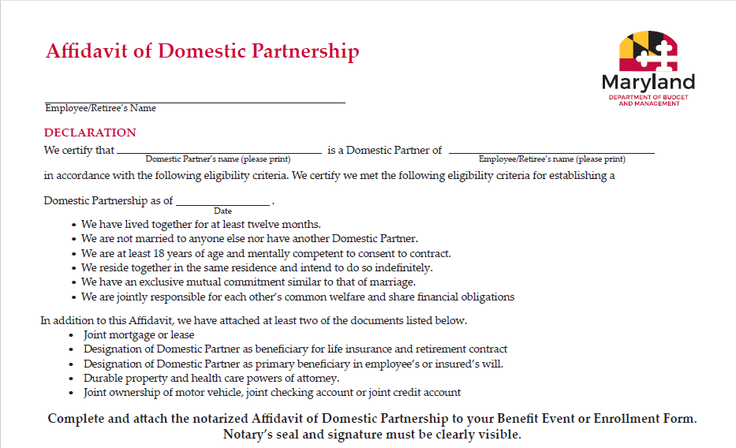
Affidavit of Domestic Partnership

Slide 32
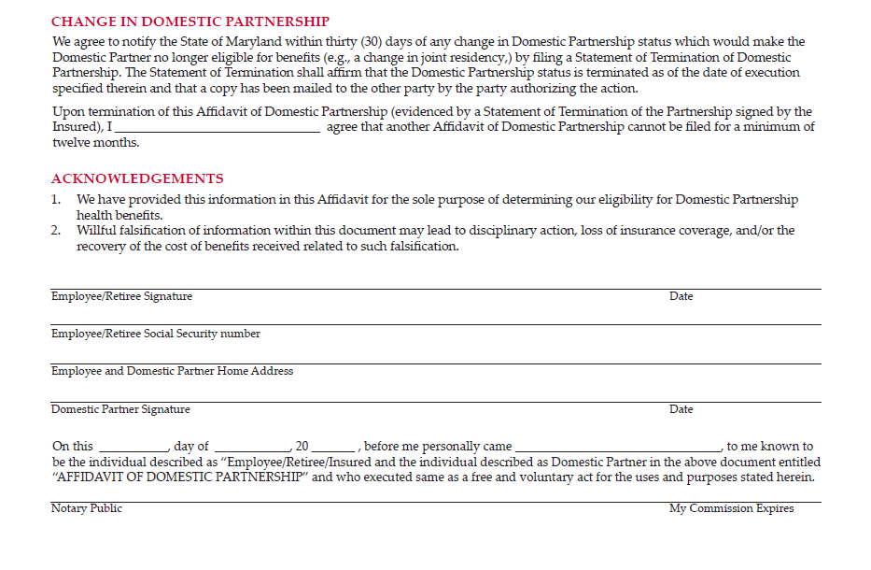
Affidavit of Domestic Partnership (cont)
Dissolution of Domestic Partnership form will be used to notify EBD of the change. Available beginning October 12 at dbm.Maryland.gov/benefits

Slide 33
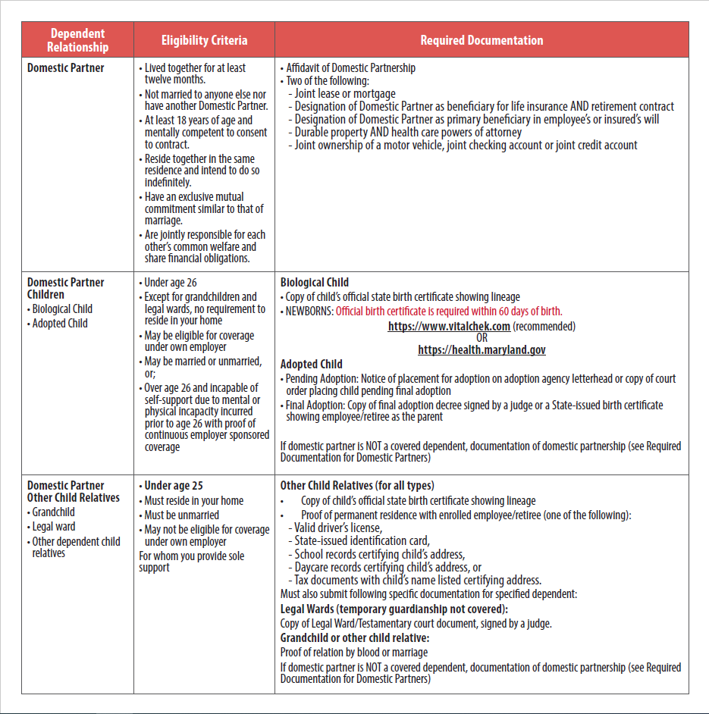
Domestic Partner Eligibility

Slide 34
Subsidy & Domestic Partners
Active Employees (State Regular-full time & Contractual ACA) will get State Subsidy for Domestic Partner/Domestic Partner Dependents.
State Regular-full time will have both pre and post-tax payroll deductions.
Imputed Income will apply
Retirees will not get State Subsidy for Domestic Partner/Domestic Partner Dependents.
Retirees are not subject to imputed income.

Slide 35
Imputed Income
Imputed Income: Each health benefit plan that includes a State subsidy for your domestic partner (and/or domestic partner’s children) is subject to tax withholding. In other words, the State’s contribution toward health benefits is considered earnings and will be included in your taxable income. This is known as imputed income.
If a domestic partner is considered a tax dependent, please see dbm.Maryland.gov/benefits for Affidavit of Domestic Partner’s Federal Tax Dependent Status and Worksheet for Determining Support.

Slide 36
Domestic Partners-FSA & COBRA
Domestic Partners are not eligible to use Medical or Dependent Care FSA benefits (unless classified as a Tax Dependent)
Domestic Partners can only enroll in COBRA as a dependent of the employee or retiree.
Domestic Partners and their dependents do not have individual COBRA rights.

Slide 37
Domestic Partners & Medicare
Domestic Partnership is not federally recognized as a relationship which would trigger a special enrollment period under Medicare.
What does this mean?
Domestic Partners who are eligible for Medicare and do not enroll when they are initially eligible, even if they are on active employee benefits, may be subject to Medicare late enrollment penalties. Contact CMS.gov or 1-800-Medicare for information.

Slide 38
EBD
Reminders

Slide 39
Reminders
Benefit Guide
Available online for everyone at DBM.Maryland.gov/benefits
Read the Benefit Guide!
Contacting EBD
SPS Ticket System
Please refrain from emailing or calling EBD staff directly
ABC’s may complete the Open Enrollment process on behalf of an employee; HOWEVER, an enrollment form must be attached to the open enrollment event
Open Enrollment closes at 5pm on November 9th!

Slide 40
Questions?

Slide 41
Thank You!
© Copyright 2019 State of Maryland. The information contained herein is subject to change without notice.

